Slide 1

MTE 546 Exam Review Session
March 2, 2024
Lyndon Tang

Slide 2
Agenda
Overview of Course Topics
Linear Regression
Weighted Fusion
Bayesian Fusion
Kalman Filters
Fuzzy Logic
Artificial Neural Networks
Open Q&A

Slide 3
Overview of Course Topics

Slide 4
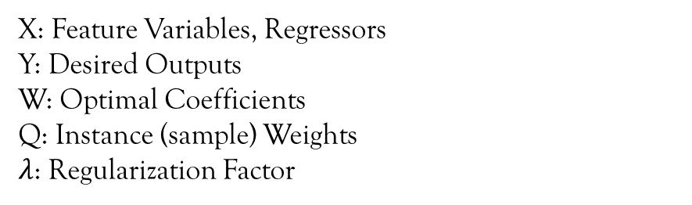




Linear Regression
Uses:
Calibration
Model Fitting
“Glue” between measurements and basic variables
Formula:
Y
X
W
$$N×1$$
$$N×k$$
$$k×1$$
W$={\left(X^{T}QX+λI\right)}^{−1}X^{T}Q$Y
X: Feature Variables, Regressors
Y: Desired Outputs
W: Optimal Coefficients
Q: Instance (sample) Weights
$λ$: Regularization Factor

Slide 5
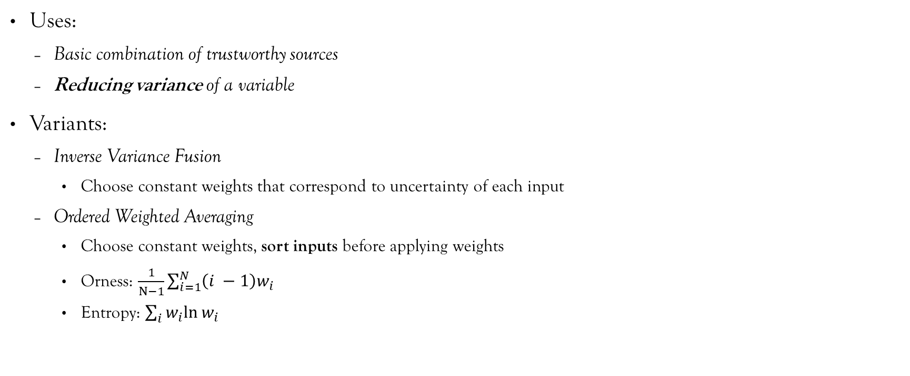
Weighted Fusion
Uses:
Basic combination of trustworthy sources
Reducing variance of a variable
Variants:
Inverse Variance Fusion
Choose constant weights that correspond to uncertainty of each input
Ordered Weighted Averaging
Choose constant weights, sort inputs before applying weights
Orness: $\frac{1}{N−1}\sum_{i=1}^{N}{\left(i −1\right)w_{i}}$
Entropy: $\sum_{i}{w_{i}ln⁡w_{i}}$
A | B | C | OR(A,B,C)
0 | 0 | 0 | 0
0 | 0 | 1 | 1
0 | 1 | 0 | 1
0 | 1 | 1 | 1
1 | 0 | 0 | 1
1 | 0 | 1 | 1
1 | 1 | 0 | 1
1 | 1 | 1 | 1
0.9 | 0.1 | 0.1 | ?

Slide 6
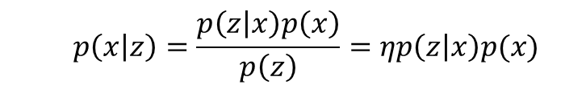
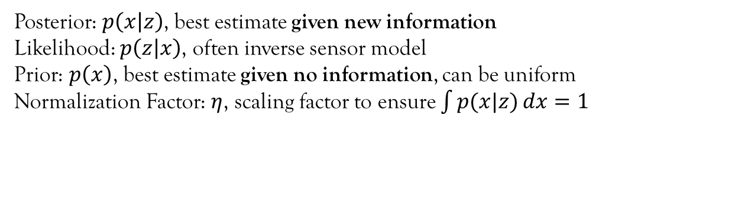
Bayesian Fusion
Uses:
Combining both the value and certainty of trustworthy sources
Formula:
$$p\left(x | z\right)=\frac{p\left(z | x\right)p\left(x\right)}{p\left(z\right)}=ηp\left(z | x\right)p(x)$$
Posterior: $p\left(x | z\right)$, best estimate given new information
Likelihood: $p\left(z | x\right)$, often inverse sensor model
Prior: $p\left(x\right)$, best estimate given no information, can be uniform
Normalization Factor: $η$, scaling factor to ensure $\int{p(x|z)}dx=1$

Slide 7
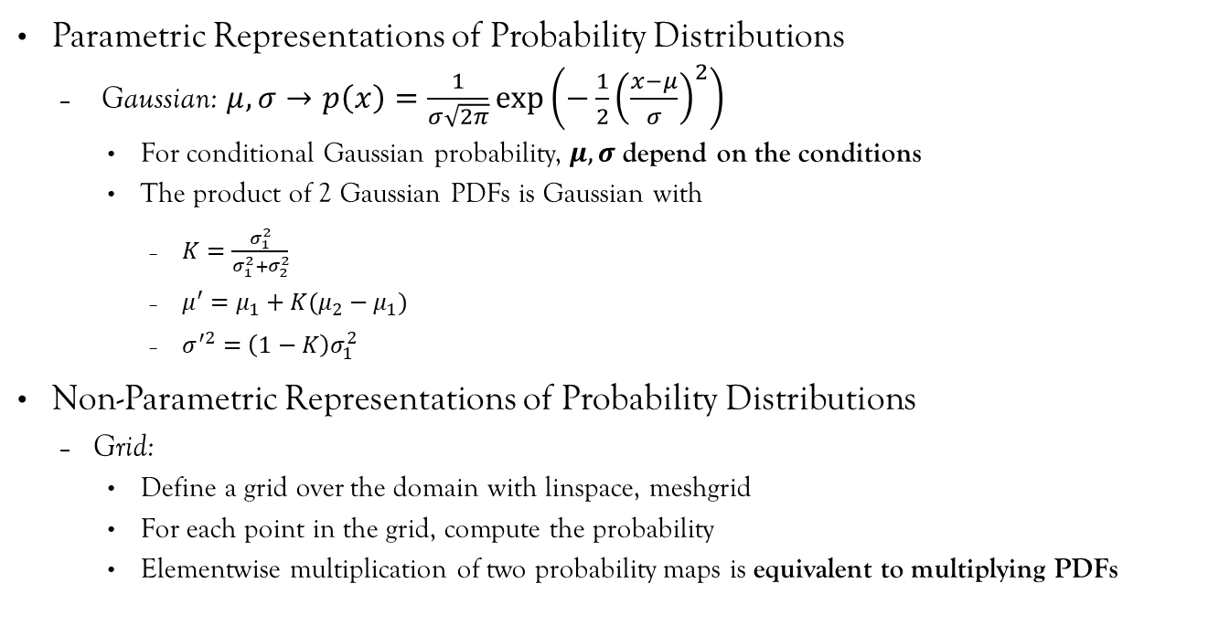
Bayesian Fusion
(1,1)
y
Parametric Representations of Probability Distributions
Gaussian: $μ,σ→p\left(x\right)=\frac{1}{σ\sqrt{2π}}\exp\left(−\frac{1}{2}{\left(\frac{x−μ}{σ}\right)}^{2}\right)$
For conditional Gaussian probability, $μ,σ$ depend on the conditions
The product of 2 Gaussian PDFs is Gaussian with
$K=\frac{σ_{1}^{2}}{σ_{1}^{2}+σ_{2}^{2}}$
$μ^{′}=μ_{1}+K(μ_{2}−μ_{1})$
$σ^{′2}=\left(1−K\right)σ_{1}^{2}$
Non-Parametric Representations of Probability Distributions
Grid:
Define a grid over the domain with linspace, meshgrid
For each point in the grid, compute the probability
Elementwise multiplication of two probability maps is equivalent to multiplying PDFs
z=p(x,y)
x
Domain
p(1,1)
y
x
Probability Map

Slide 8

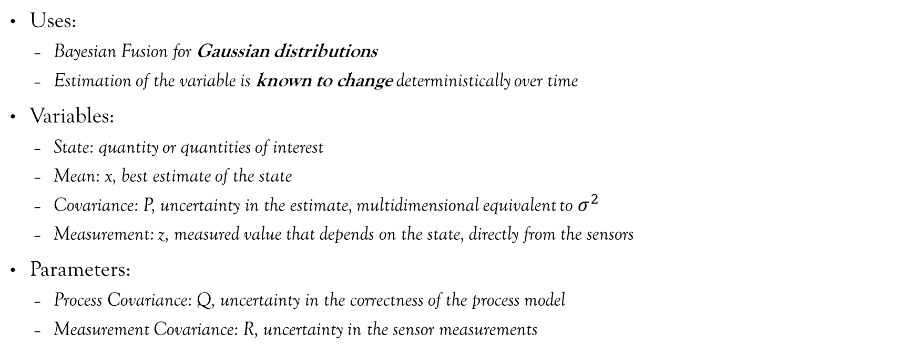
Kalman Filters
Uses:
Bayesian Fusion for Gaussian distributions
Estimation of the variable is known to change deterministically over time
Variables:
State: quantity or quantities of interest
Mean: x, best estimate of the state
Covariance: P, uncertainty in the estimate, multidimensional equivalent to $σ^{2}$
Measurement: z, measured value that depends on the state, directly from the sensors
Parameters:
Process Covariance: Q, uncertainty in the correctness of the process model
Measurement Covariance: R, uncertainty in the sensor measurements
p(x)
P
x
$$μ$$

Slide 9
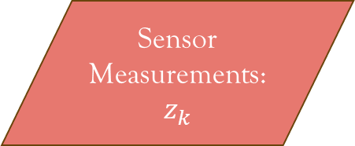
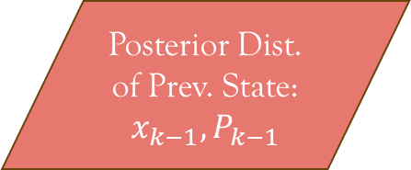


Kalman Filters
Posterior Dist. of Prev. State: $x_{k−1}, P_{k−1}$
Predict
Prior Dist. of Current State: $x_{k}, P_{k}$
Posterior Dist. of Current State: $x_{k}, P_{k}$
Correct
Sensor Measurements: $z_{k}$

Slide 10

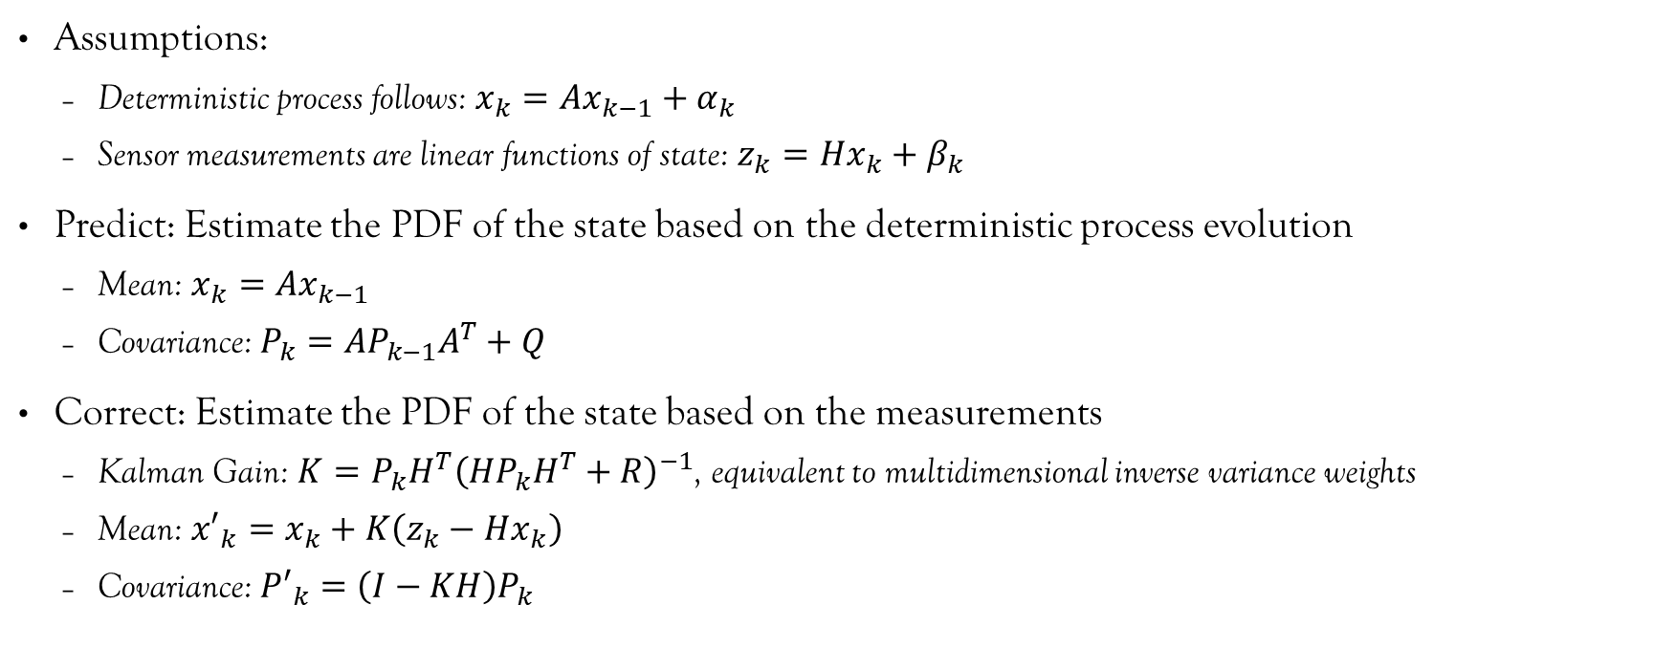

Standard Kalman Filter
Assumptions:
Deterministic process follows: $x_{k}=Ax_{k−1}+α_{k}$
Sensor measurements are linear functions of state: $z_{k}=Hx_{k}+β_{k}$
Predict: Estimate the PDF of the state based on the deterministic process evolution
Mean: $x_{k}=Ax_{k−1}$
Covariance: $P_{k}=AP_{k−1}A^{T}+Q$
Correct: Estimate the PDF of the state based on the measurements
Kalman Gain: $K=P_{k}H^{T}{\left(HP_{k}H^{T}+R\right)}^{−1}$, equivalent to multidimensional inverse variance weights
Mean: ${x′}_{k}=x_{k}+K\left(z_{k}−Hx_{k}\right)$
Covariance: ${P′}_{k}=\left(I−KH\right)P_{k}$
$$α_{k}\sim N(0,Q)$$
$$β_{k}\sim N(0,R)$$

Slide 11

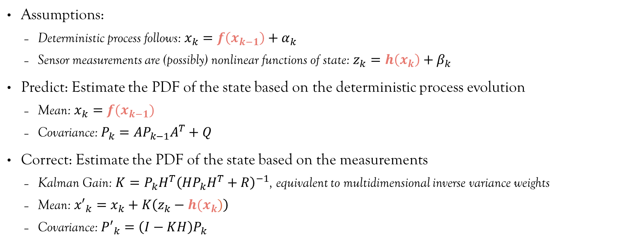

Extended Kalman Filter
Assumptions:
Deterministic process follows: $x_{k}=f\left(x_{k−1}\right)+α_{k}$
Sensor measurements are (possibly) nonlinear functions of state: $z_{k}=h\left(x_{k}\right)+β_{k}$
Predict: Estimate the PDF of the state based on the deterministic process evolution
Mean: $x_{k}=f(x_{k−1})$
Covariance: $P_{k}=AP_{k−1}A^{T}+Q$
Correct: Estimate the PDF of the state based on the measurements
Kalman Gain: $K=P_{k}H^{T}{\left(HP_{k}H^{T}+R\right)}^{−1}$, equivalent to multidimensional inverse variance weights
Mean: ${x′}_{k}=x_{k}+K\left(z_{k}−h(x_{k})\right)$
Covariance: ${P′}_{k}=\left(I−KH\right)P_{k}$
$$α_{k}\sim N(0,Q)$$
$$β_{k}\sim N(0,R)$$
$$A=\frac{∂f}{∂x}$$
$$H=\frac{∂h}{∂x}$$

Slide 12





Unscented Kalman Filter
Used for highly nonlinear processes
Main idea is to trace points around the mean to get their future values and spread
$$x_{2}$$
$$x_{2}$$
Mean
New mean
New covariance
$\left[\begin{matrix}x_{1} \\ x_{2}\end{matrix}\right]$=$\left[\begin{matrix}f_{1}\left(x_{1},x_{2}\right) \\ f_{2}\left(x_{1},x_{2}\right)\end{matrix}\right]$
4 sample points
$$x_{1}$$
$$x_{1}$$

Slide 13
Interacting Multiple Model KF
Used for tracking when the process model is not known
Steps:
Propose multiple candidates for the process model
Apply Kalman prediction step using each process model
Fuse the estimates from each model together
Apply Kalman correction step to the fused estimate
Reinitialize every process model with the fused, corrected estimate

Slide 14


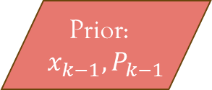
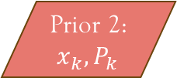
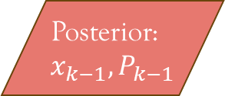

Interacting Multiple Model KF
Model 1
Prior 1: $x_{k}, P_{k}$
Measurements: $z_{k}$
Fuse
Model 2
Prior 2: $x_{k}, P_{k}$
Prior: $x_{k−1}, P_{k−1}$
Correct
Posterior: $x_{k−1}, P_{k−1}$
…
…
Model N
Prior N: $x_{k}, P_{k}$

Slide 15
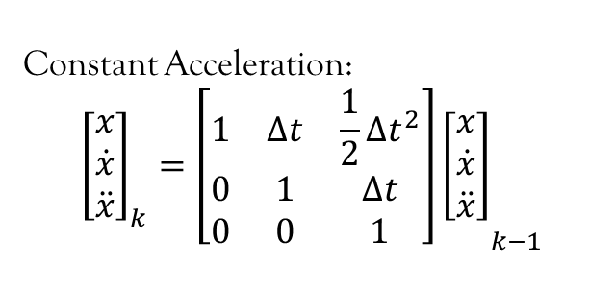
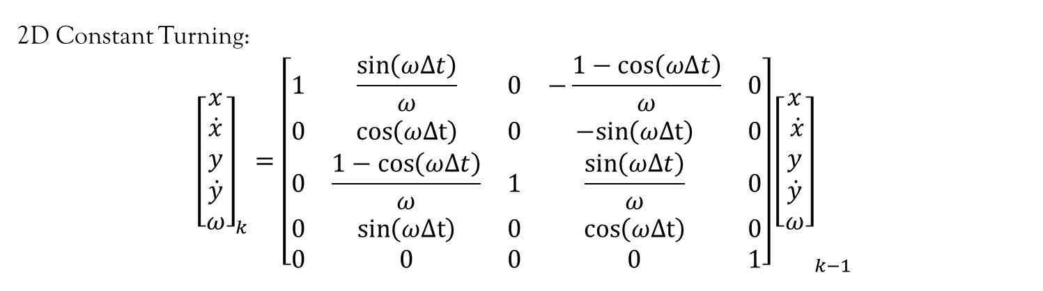
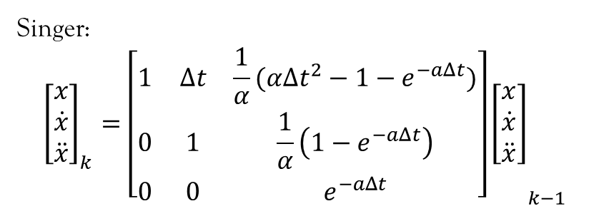
Tracking Models [2]
Constant Acceleration:
$${\left[\begin{matrix}x \\ \dot{x} \\ \ddot{x}\end{matrix}\right]}_{k}={\left[\begin{matrix}1 & Δt & \frac{1}{2}Δt^{2} \\ 0 & 1 & Δt \\ 0 & 0 & 1\end{matrix}\right]\left[\begin{matrix}x \\ \dot{x} \\ \ddot{x}\end{matrix}\right]}_{k−1}$$
Singer:
$${\left[\begin{matrix}x \\ \dot{x} \\ \ddot{x}\end{matrix}\right]}_{k}={\left[\begin{matrix}1 & Δt & \frac{1}{α}(αΔt^{2}−1−e^{−aΔt}) \\ 0 & 1 & \frac{1}{α}\left(1−e^{−aΔt}\right) \\ 0 & 0 & e^{−aΔt}\end{matrix}\right]\left[\begin{matrix}x \\ \dot{x} \\ \ddot{x}\end{matrix}\right]}_{k−1}$$
2D Constant Turning:
$${\left[\begin{matrix}x \\ \dot{x} \\ y \\ \dot{y} \\ ω\end{matrix}\right]}_{k}={\left[\begin{matrix}1 & \frac{\sin\left(ωΔt\right)}{ω} & 0 & −\frac{1−\cos\left(ωΔt\right)}{ω} & 0 \\ 0 & \cos\left(ωΔt\right) & 0 & −sin\left(ωΔt\right) & 0 \\ 0 & \frac{1−cos\left(ωΔt\right)}{ω} & 1 & \frac{\sin\left(ωΔt\right)}{ω} & 0 \\ 0 & \sin\left(ωΔt\right) & 0 & \cos\left(ωΔt\right) & 0 \\ 0 & 0 & 0 & 0 & 1\end{matrix}\right]\left[\begin{matrix}x \\ \dot{x} \\ y \\ \dot{y} \\ ω\end{matrix}\right]}_{k−1}$$

Slide 16
Fuzzy Logic
Main Idea: Combine information using linguistic logic to determine a single action
IF money > $5 AND I am hungry THEN buy pizza
IF free food in E7 OR (brought lunch AND money < $10) THEN do not buy lunch
When the information is partially true, the resulting action is not clear

Slide 17
Fuzzy Logic Design
Define a set of membership classes
Define which inputs belong to the class
Define the action that occurs for the class
Define a membership function: High values if the inputs are members, low values otherwise
Define if-then rules that map classes to actions
Define an action function: High values if the class results in the action, low values otherwise
Membership
Membership
Input
Action

Slide 18
Fuzzy Logic Application
Get measurements of the inputs
Compute the membership of the inputs for each of the classes
Compute the action value depending on the logic type:
Mamdani Logic:
Project the membership score over to the action function
Take the centroid of the area under the membership score
Membership
Membership
y
Input
Action
x

Slide 19
Fuzzy Logic Application
Compute the action value depending on the logic type:
Sugeno Logic:
Project the membership score over to the action function
Compute the action function at the membership score
Membership
Action
m
y
Input
Membership
x
m

Slide 20
Fuzzy Logic Application
Combine actions of multiple classes depending on the logic type:
Mamdani Logic:
Merge membership areas and take centroid
Sugeno Logic:
Take a weighted average of the action values with the membership score as the weights
Mamdani Logic:
Sugeno Logic:
Membership
Membership
Action
Action
y
y

Slide 21
Comparison of Fuzzy Logic Systems
Mamdani logic is better suited for decision making
Sugano logic is better suited for continuous control systems
 | Mamdani | Sugeno
Interpretability | Simple | Complex
Continuity | No guarantee of continuity | Output is continuous wrt. inputs
Computational Complexity | Requires computation of centroid (integral) of membership functions | Low-cost weighted sum

Slide 22
Fuzzification Operators
Fuzzification extends the Logical AND and Logical OR operators to non-binary numbers

Slide 23
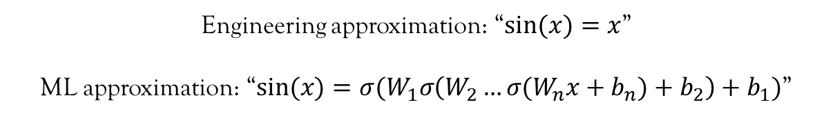
Artificial Neural networks
Artificial Neural Networks are universal function approximators
Compactly compute values of (very) high dimensional, complex functions that are:
impractical to determine analytically; or
impractical to fit using a simple regression method (Linear Regression)
Engineering approximation: “$sin⁡(x)=x$”
ML approximation: “$sin⁡(x)=σ(W_{1}σ\left(W_{2}…σ(W_{n}x+b_{n})+b_{2}\right)+b_{1})$”

Slide 24
Artificial Neural networks
Steps for designing an Artificial Neural Network (ANN):
Create or find a dataset that has feature variables and their corresponding labels
Choose regressor variables as functions of the feature variables
Choose a neural network architecture
Feedforward vs recursive
Deep vs shallow
Choose an optimizer
Split dataset into training, validation, and test sets
Run the optimizer until the performance on the validation set meets specifications
Evaluate performance on the test set

Slide 25
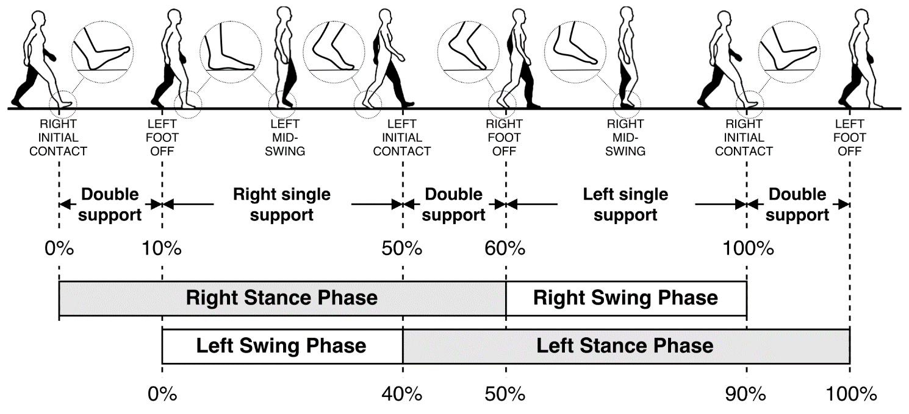
ANN Example: Gait Phase Regression
Gait phase quantifies how far along in a step a person is
Useful for analyzing gait
Allows reference to a consistent part of the gait (heel strike, toe off, peak swing)
Want to estimate gait phase in real time using joint angles
Many-(joint angles)-to-one-(gait phase) mapping
Fig 1. Gait phase is used to identify important points in the gait cycle [1]

Slide 26
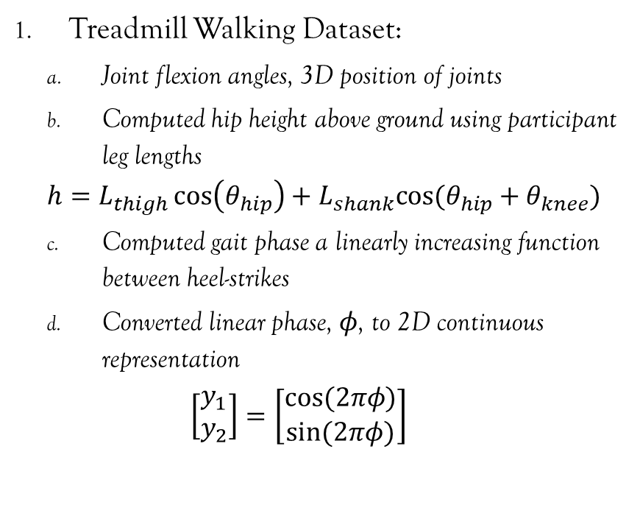
ANN Example: Gait Phase Regression
Treadmill Walking Dataset:
Joint flexion angles, 3D position of joints
Computed hip height above ground using participant leg lengths
$$h=L_{thigh}\cos\left(θ_{hip}\right)+L_{shank}cos⁡(θ_{hip}+θ_{knee})$$
Computed gait phase a linearly increasing function between heel-strikes
Converted linear phase, $φ$, to 2D continuous representation
$$\left[\begin{matrix}y_{1} \\ y_{2}\end{matrix}\right]=\left[\begin{matrix}cos⁡(2πφ) \\ sin⁡(2πφ)\end{matrix}\right]$$
Create or find a dataset that has feature variables and their corresponding labels
Choose regressor variables as functions of the feature variables

Slide 27

ANN Example: Gait Phase Regression
Chose recursive LSTM architecture
6 Inputs: hip, knee flexion angles and hip height for each leg
4 outputs: 2D gait phase representation for each leg
Choose a neural network architecture
Feedforward vs recursive
Deep vs shallow
R Hip flex. angle
R Knee flex. Angle
R Hip Height
L Hip flex. angle
L Knee flex. Angle
L Hip Height
LSTM Network
R $y_{1}$
R $y_{2}$
L $y_{1}$
L $y_{2}$
Labels
Regressors

Slide 28
ANN Example: Gait Phase Regression
Typically start with ADAM
Use trial and error to see if other optimizers are suited to the problem
Chose Mean Squared Error as the loss function
The loss function changes the “goals” of the optimization
Choose an optimizer

Slide 29
ANN Example: Gait Phase Regression
Chose 14:1:1 split for TVD
Chose number of epochs only as large as necessary for validation loss to deflect upwards
After training, computed estimates for test dataset
Computed Root Mean Squared Error (RMSE) for test estimates
If RMSE not small enough, iterate on:
Learning rate
Number of epochs
ANN architecture
Regressors
Split dataset into training, validation, and test sets
Run the optimizer until the performance on the validation set meets specifications
Evaluate performance on the test set

Slide 30
Thanks for Listening,
Questions?

Slide 31
References
Tunca, C.; Pehlivan, N.; Ak, N.; Arnrich, B.; Salur, G.; Ersoy, C. Inertial Sensor-Based Robust Gait Analysis in Non-Hospital Settings for Neurological Disorders. Sensors 2017, 17, 825. https://doi.org/10.3390/s17040825
MathWorks. “Motion Model, State, and Process Noise – MATLAB & Simulink (mathworks.com).” mathworks.com. https://www.mathworks.com/help/fusion/ug/motion-model-state-and-process-noise.html (accessed Mar. 27, 2024).

